Slide 1
Nuance Speech Solutions
Parteek Singh

Slide 2



Today’s consumer is…
Connected
Informed
Empowered
IMPATIENT!
2
© 2002-2011 Nuance Communications, Inc. All rights reserved.

Slide 3

What is Nuance doing?
Extend Technology Leadership
Speech recognition
Text to speech
Voice Biometric
Customer Care
Information/Entertainment
Mobile Devices/Embedded
Diversified Market
Language Investment
TTS supports 60+ languages
ASR supports 70+ languages
Dragon Dictation
Expand Global
Expertise
R&D centers in India
Speech Scientists
UI Designers
Flexible Solutions
Options for On-Demand, On-Premise and embedded solutions

Slide 4





Nuance Speech Offerings
A portfolio of products that improve Discovery, Accessibility, Connectivity, and Simplicity for mobile customers
Automatic Speech Recognition
Speech-enable your apps to improve ease of use and content discovery.
Deployment in 70+ languages
Support 14 Indian languages.
Text To Speech
Give your apps a voice
Support for Indian English and Hindi.
Four Regional language coming in FY’12
Support for Indian English and Hindi
Text Input Solutions
Dictate_
Type_ _
Write__
Swypei_
Embedded on 6 billion + handsets worldwide.
Support for 13 Indian languages
UNDERSTAND
COMMUNICATE
Notes:
The new, modular product strategy is aimed at Smartphone Apps is already paying off at:
Voadafone UK
Telenor Sweden
While we expect 80% of the opportunity to come from the product portfolio, there are times when a company needs a whole new solution: an app needs to be built/rebuilt from the ground up (like Optus and Dell). If a customer wants us and our products, we can deliver. The key is to sell apps that include Nuance technology for a minimum of $100k. We are not competitive just selling generic mobile app dev. There are a lot of dev shops out there at low price points with very quick turnaround times.
Overall, we can think of professional services for Nuance Mobile Advantage as being very similar to our current call center offerings
Caller Experience services for application design and speech science
Systems integration and CTI
Full Application services for end-to-end delivery*
*In general, while we are looking for opportunities to enhance existing mobile apps, we can also support projects, like Dell, where we manage the entire project building a mobile app from scratch. The key is to sell apps that include Nuance technology for a minimum of $100k. We are not competitive just selling generic mobile app dev. There are a lot of dev shops out there at low price points with very quick turnaround times.

Slide 5

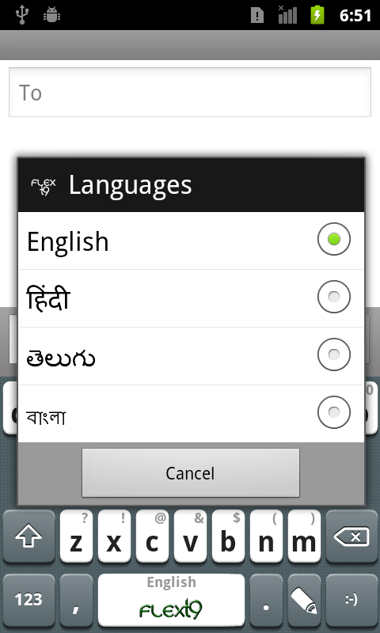
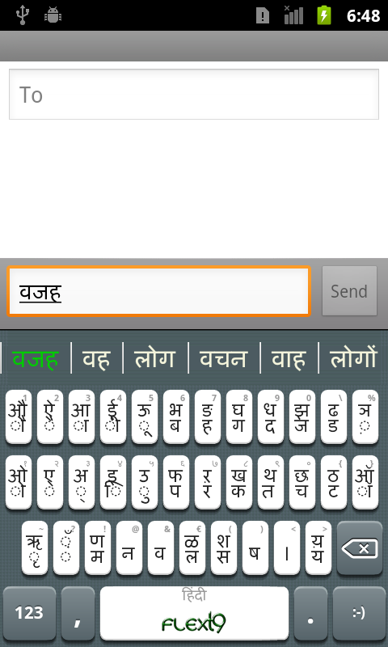
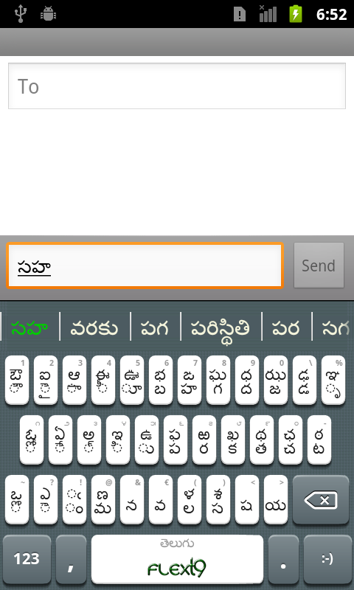
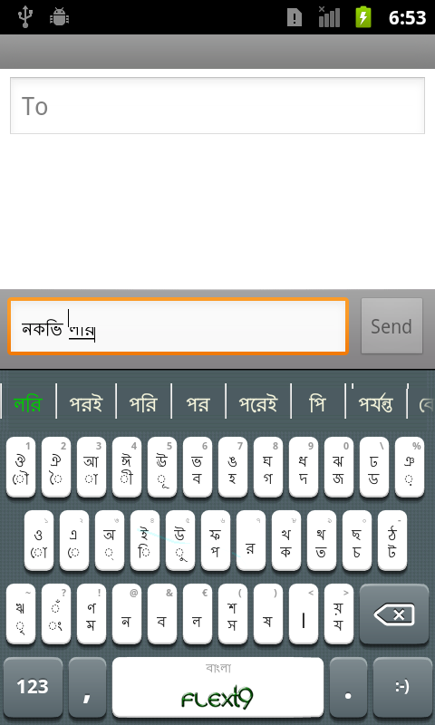
Text Input: Indic Support
English
Hindi
Telugu
Bengali

Slide 6
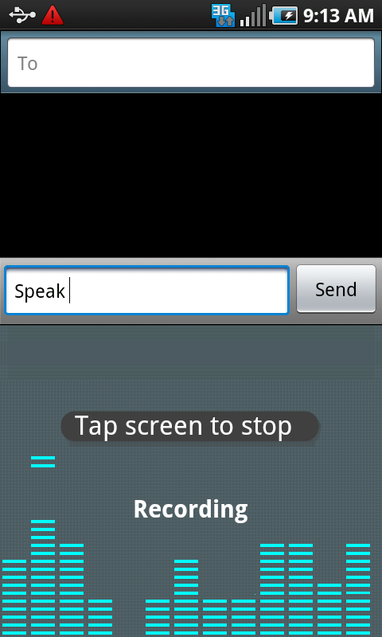
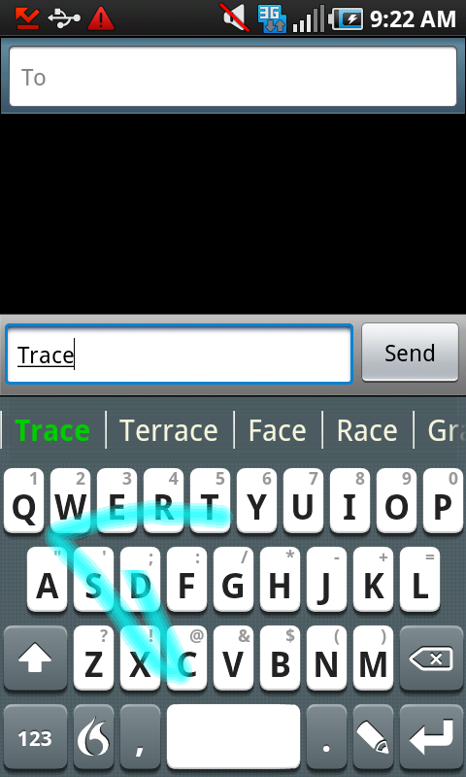
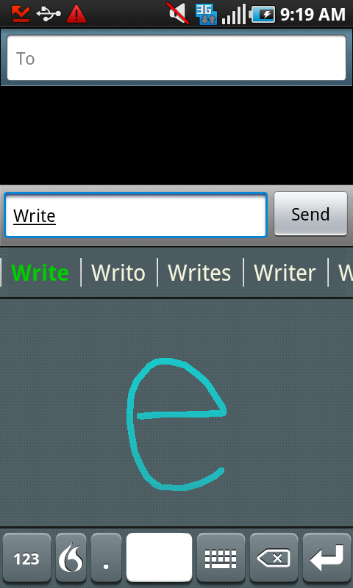



Text Input Solutions: flexT9
(40 sec)
Notes:
We have a suite of text input applications in over 80 languages including 13 Indian languages (Hinglish, Hindi, Assamese, Bengali, Gujarati, Kannada, Malyalam, Marathi, Oriya, Punjabi, Tamil, Telugu) for feature phones to high end tablets. Our solutions in this space range from tap, touch, swype, write & speak, basically covering all form of inputs. These solutions don’t merely allow text input but use sophisticated language models such as next word prediction, auto correction etc. to make the customer experience simple.

Slide 7
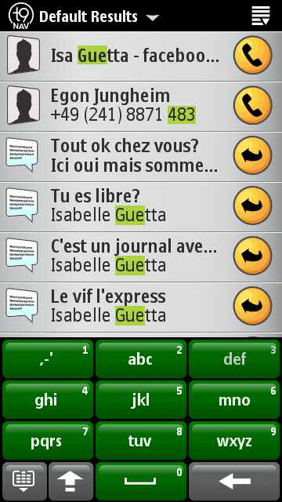
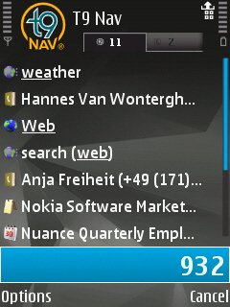
Text Input Solutions: T9 Nav
(40 sec)
Notes:
We have a suite of text input applications in over 80 languages including 13 Indian languages (Hinglish, Hindi, Assamese, Bengali, Gujarati, Kannada, Malyalam, Marathi, Oriya, Punjabi, Tamil, Telugu) for feature phones to high end tablets. Our solutions in this space range from tap, touch, swype, write & speak, basically covering all form of inputs. These solutions don’t merely allow text input but use sophisticated language models such as next word prediction, auto correction etc. to make the customer experience simple.

Slide 8


Nuance Offering: ASR
Nuance Recognizer 9
Most accurate speech engine in the world
  Speech recognition for 14 Indian languages
  Works in Noisy environment
  Support for Natural language understanding
  Supports W3C standard specs (SRGS, SISR)

Slide 9



Indian Deployments
SBI Mutual Fund
Yes Bank
Self Service

Slide 10
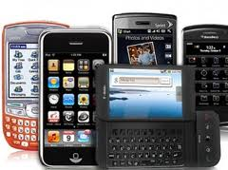
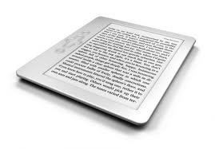
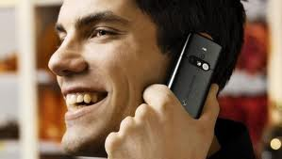
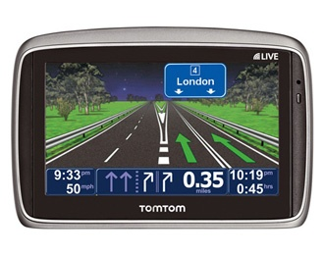
Nuance Offering: Text to Speech
Vocalizer 5.0
The Next Generation of Speech
  More than just great TTS – a total speech output solution
  Drive all speech output through the same channel
  Supports W3C Standard (SSML)
Mobiles
IVR
Navigation Devices/Cars
Tablets/E-book readers

Slide 11

Indian English and Hindi
Over 350,000 Hindi proper names data in an internal dictionary
A user dictionary formatted for railroad applications with 10K station names
A list of 42426 post office names (can assume cities/villages) and 16476 cities
Voice Names:
Indian English (Sangeeta)
Hindi (Lekha)

Slide 12


Nuance Text-to-Speech: Features
Expressiveness: For example: asking questions with rising intonation.
    Indian English example
Controlling Rate: For example, Playing address Vs. Generic information
Natural Prosody:
Multi-lingual Capabilities:

Slide 13
Notes:
You’ve earned the right to tell this story, and we have an organized SME team in place with tools and experience to help you tell it.

